Slide 1

Temperature

Slide 2
Temperature
Temperature is a measure of the intensity of heat of a body
But how does one measure this for oceans?
Several forms depending on the topic of study.

Slide 3
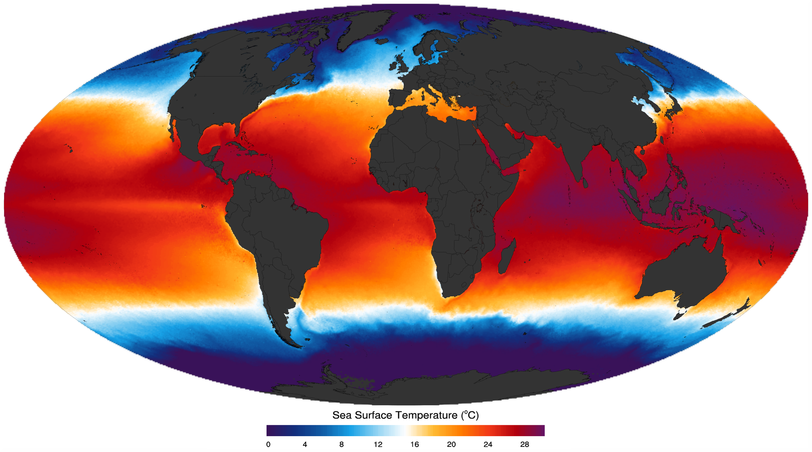
https://podaac.jpl.nasa.gov/datasetlist?search=MODIS_AQUA_L3_SST_THERMAL_MONTHLY_4KM_NIGHTTIME
The temperature of seawater is fixed at the sea surface by heat exchange with the atmosphere. The average incoming energy from the sun at the earth's surface is about four times higher at the equator than at the poles.
Water is transparent, so the radiation penetrates some distance below the surface; heat is also carried to deeper levels by mixing. Due to the high specific heat of water, diurnal and seasonal temperature variations are relatively small compared to the variations on land; oceanic temperature variations are on the order of a few degrees, except in very shallow water.
Most solar energy is absorbed within a few meters of the ocean surface, directly heating the surface water and providing the energy for photosynthesis by marine plants and algae. Shorter wave lengths penetrate deeper than longer wavelengths.
Heat conduction by itself is extremely slow, so only a small proportion of heat is transferred downwards by this process.

Slide 4
Skin temperature:
It is the difference between the skin and bulk temperature that is directly related to the wind speed and the net air–sea heat flux.
Sea Surface Temperature (SST):
Subsurface temperature
Vertical temperature profile

Slide 5
Between about 200 m and 1000 m depth, the temperature declines rapidly throughout much of the ocean.
From about 1000 m to the ocean floor, there is virtually no seasonal variation and the temperatures are around 2ºC.
This narrow range is maintained throughout the deep oceans, both geographically and seasonally, because it is determined by the temperature of the cold, dense water that sinks at the polar-regions and flows towards the Equator.
Vertical distribution of temperature in the deep ocean is controlled by density driven water movements.
The main mechanism to transfer heat deeper is turbulent mixing by winds and waves, which establishes a mixed surface layer that can be as thick as 200-300 meters or even more at mid-latitudes in the open ocean in winter or less than 10 meters in sheltered coastal waters in summer.
https://rwu.pressbooks.pub/webboceanography/chapter/6-2-temperature/
Notes:
5

Slide 6
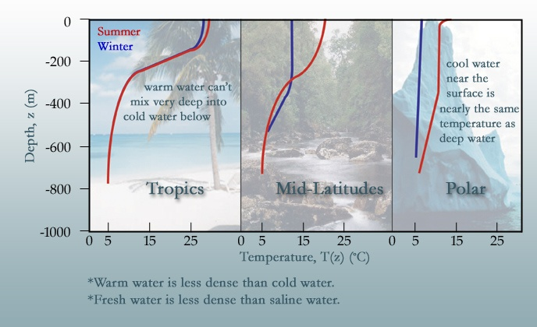
Notes:
6

